Slide 1
Finishing up the puzzle

Slide 2
mnemonics
Loci – associate with places
Walk through campus, leave STM at the arch…
Parts of the brain = fist
Peg word – set of words use as pegs to “hang” memory
One is a bun, two is a shoe, Ebbinghaus with bun on his head, a shoe kicking the yerkes-dodson curve
Keyword – associate with another word
Hippocampus, associate with hippopotamus, think of a couple of hippopotami passing a ball back and forth = hippocampus receives info from sensory cortex and sends it back, over and over in rehearsal.

Slide 3
mnemonics
Acronym – use first letters of words to form acronym
LAPAK = loci, acronym, peg, acrostic, keyword
Acrostic – use first letters to form new words and make a sentence
Logan Always Plays with Angie’s Kite

Slide 4
Forgetting
Interference
Proactive – old memories hurt recovery of new
Retroactive – new memories hurt recovery of old
Decay – fade over time
Failure to encode – lack of attention at encoding
Retrieval failure – inability to find cue

Slide 5
Encoding (can affect failure to encode and failure to retrieve)
Levels of Processing
Distinctiveness and elaboration
Self-reference effect
Context effects
Emotion/mood and physical conditions
Goals and memory

Slide 6
Forgetting
Motivated forgetting – refusal to talk about something traumatic, leads to forgetting
Repression – unknowing push of threatening thoughts from consciousness

Slide 7
False Memories
Distortion of actual event or a completely imagined event
Can involve mixing fragments of actual stories

Slide 8
False Memories
Story created :
Current context – includes questions
Desire to tell coherent story
Current mental state and beliefs
Repressed memories
May be real
May be result of encouragement, prodding, suggestion
Dreams and hypnosis – use caution
Children particularly susceptible

Slide 9
False Memories
Loftus and Palmer (1974)
how fast were the cars going when they
contacted (31.8mph)
Smashed (40.8mph)
Hyman, Husband & Billings (1995)
Contact parents for stories
Interview students about real and 1 false event
1 week later 20% memory of false event

Slide 10
Autobiographical Memory
Knowledge of self
Part of identity
Verbal narrative, imagery about events, emotional reactions, procedural information
Is reconstructive
As we remember we change information

Slide 11
Flashbulb Memory
Memory for a situation in which a person first learned of a very surprising and emotionally arousing event.
Vivid memory for place and people around
If you are closer to event (lived in NY on Sept 11) better accuracy with details of event itself

Slide 12
Procedural vs. Declarative
Procedural – implicit, how to do something
How to do a kata
Declarative – explicit, facts and episodes
Why you keep your hands by your head when sparring
http://il.youtube.com/watch?v=DR1BNetJz94

Slide 13
Semantic vs. Episodic
Semantic
Organized knowledge about the world, including words, and facts
Isshinryu means one-heart-way
Episodic
memories for events, things that happen to you
Sparring one night, Brittany punched me in the nose

Slide 14
Implicit vs. Explicit
Explicit
Conscious, able to talk about
Test - recall and recognition
What is the type of karate I practice?
Implicit
Unconscious, facilitating performance
Test – see material, the fill in blanks
_s_h_n_y_

Slide 15
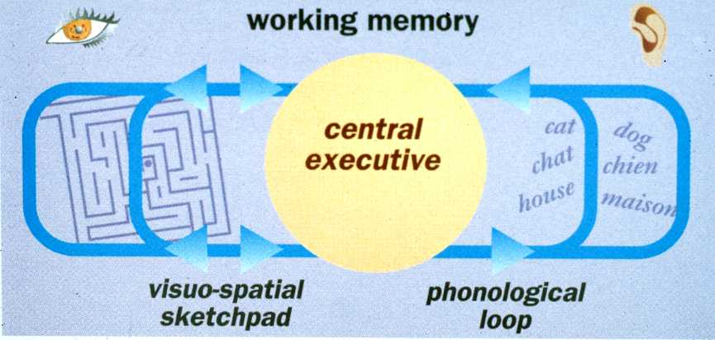
Working memory model

Slide 16
STM
Capacity = 7+/-2
Chunking
Group items into meaningful units to increase # items remembered
4237465213 (10 numbers)
423-746-5213 (10 numbers in 3 chunks)
Brown Peterson-technique
Study 3 words or letters
Prevent rehearsal (counting backwards by 7’s)
Even short delays result in poor recall

Slide 17
VLTM
Info stored early in life that remains available for the entire lifespan
Name and faces of HS classmates
Spanish

